Slide 1
CS118 – Programming Fundamentals
Lecture # 22
Monday, November 13, 2019
FALL 2019
FAST – NUCES, Faisalabad Campus
Course Instructor:
Ebad Majeed
Slides Credit:
Rizwan Ul Haq

Slide 2
Quiz 03
Given an integer array of size: 05. Write a program to find any negative number in the array. If found replace that negative number with 0.

Slide 3
Array as a parameter to Functions
Arrays are passed by reference only
The symbol & is not used when declaring an array as a formal parameter
The size of the array is usually omitted
If provided, it is ignored by the compiler
E.g.
void foo(double firstList[], int secondList[])
{
.
.
.
}

Slide 4
Arrays as Parameters to Functions
void initialize(int list[], int listSize)
{
int count;
for (count = 0 ; count < listSize ; count++)
list[count] = 0;
}
The first parameter of the function initialize is an int array of any size
When the function initialize is called, the size of the actual array is passed as the second parameter of the function initialize

Slide 5
Passing an Entire Array
Use the array name, without any brackets, as the argument
Can also pass the array size so the function knows how many elements to process
void printGrades(int[], int); // prototype
void printGrades(int A[], int size) // header
printGrades(tests, 5); // call

Slide 6
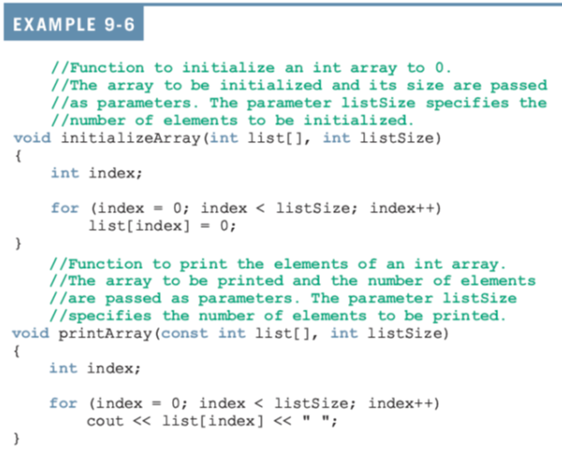
Constant Arrays as Formal Parameters

Slide 7
Base Address of an Array and Array in Computer Memory
The base address of an array is the address, or memory location of the first array component
If list is a one-dimensional array, its base address is the address of list[0]
When we pass an array as a parameter, the base address of the actual array is passed to the formal parameter

Slide 8
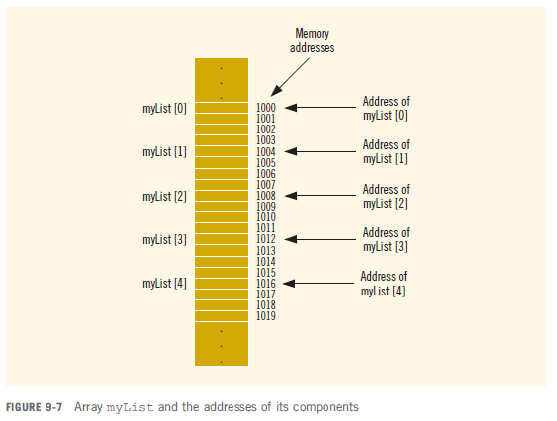
Base Address of an Array and Array in Computer Memory (cont’d.)

Slide 9
Base Address of an Array and Array in Computer Memory (cont’d.)
Consider the following statement:
cout << myList << endl; //Line 2
This statement will not output the values of the components of myList
In fact, the statement outputs the value of myList, which is the base address of the array
This is why the statement will not generate a syntax error

Slide 10
Base Address of an Array and Array in Computer Memory (cont’d.)
Suppose that you also have the following statement:
int yourList[5];
Then, in the statement:
if (myList <= yourList)
It does not determine whether the elements of myList are less than or equal to the corresponding elements of yourList

Slide 11
Base Address of an Array and Array in Computer Memory (cont’d.)
when you declare an array, the only things about the array that the computer remembers are:
Name of the array
Its base address
The data type of each component
and (possibly) the number of components

Slide 12
Example
Suppose you want to access the value of myList[3]
Now, the base address of myList is 1000
Each component of myList is of type int, so it uses four bytes to store a value, and the index is 3
To access the value of myList[3], the computer calculates the address
1000 + 4 * 3 = 1000 + 12 = 1012
That is, this is the starting address of myList[3]
So, starting at 1012, the computer accesses the next four bytes

Slide 13
Example
void arrayAsParameter(int list[], int size)
{
...
list[2] = 28; //Line 4
...
}
Suppose that you have the following call to this function:
arrayAsParameter(myList, 5);
list[2] = 28; This statement stores 28 into list[2]. To access list[2], the computer calculates the address as follows: 1000 + 4 * 2 = 1008

Slide 14
Functions Cannot Return a Value of the Type Array
C++ does not allow functions to return a value of the type array

Slide 15
Searching an Array for a Specific Item
Sequential search or linear search
Searching a list for a given item
Starting from the first array element
Compare searchItem with the elements in the array
Continue the search until either you find the item or no more data is left in the list to compare with searchItem

Slide 16
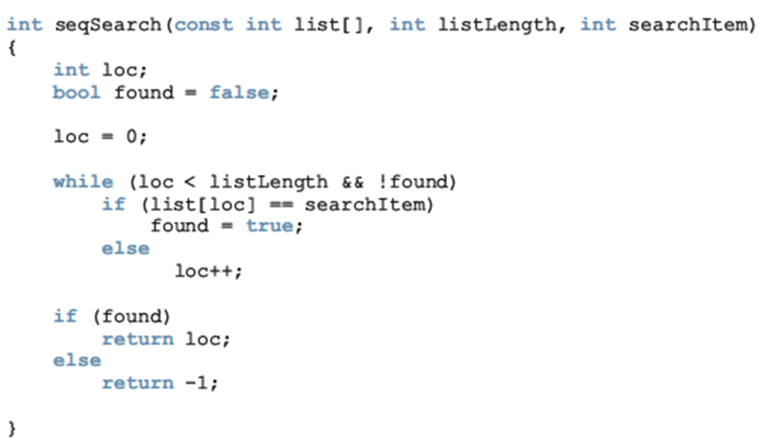
Searching an Array for a Specific Item (cont'd.)

Slide 17
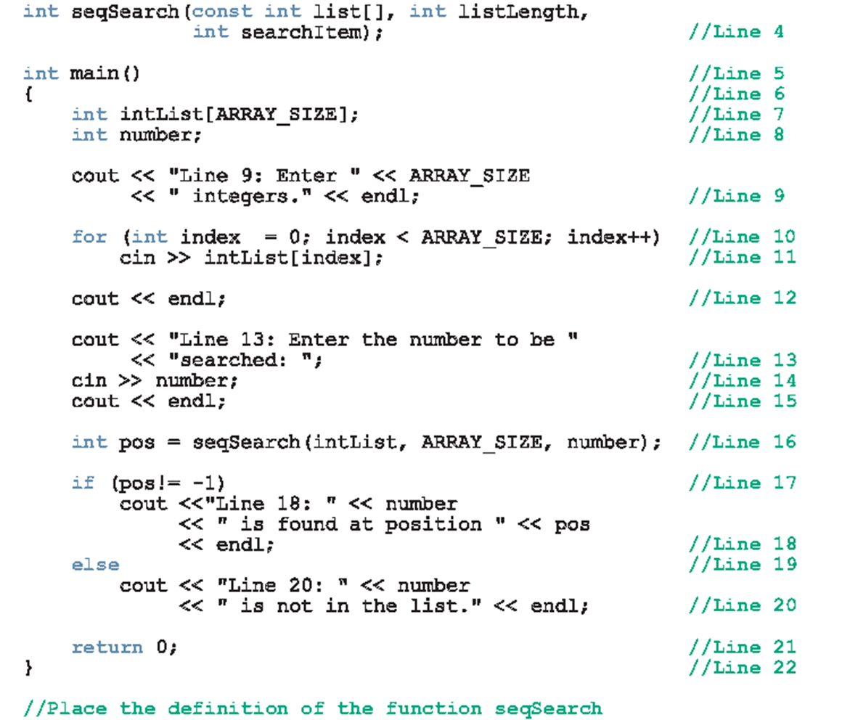

Slide 18
Bubble Sort
Sort an unsorted array
Compares two adjacent items and if the item at index i is less than item at index i+1 then swap those two
In this way largest element bubbles up to the end
void bubblesort(int A[],int size)
{
int temp ;
for ( int i = 0; i < size; ++i )
for(int j = 1 ; j < size ; ++j)
{
if(A[j-1] > A[j])
{
temp = A[j-1] ;
A[j-1] = A[j];
A[j] = temp;
}
}
}

Slide 19
Bubble Sort (Second Pass)
First Pass with i = 0 and j = 1 to size-1
[0] | [1] | [2] | [3] | [4] | [5] | [6] | [7] |  | j
16 | 30 | 24 | 7 | 62 | 45 | 5 | 55
16 | 30 | 24 | 7 | 62 | 45 | 5 | 55 | No Exchange | 1
16 | 24 | 30 | 7 | 62 | 45 | 5 | 55 | Exchange | 2
16 | 24 | 7 | 30 | 62 | 45 | 5 | 55 | Exchange | 3
16 | 24 | 7 | 30 | 62 | 45 | 5 | 55 | No Exchange | 4
16 | 24 | 7 | 30 | 45 | 62 | 5 | 55 | Exchange | 5
16 | 24 | 7 | 30 | 45 | 5 | 62 | 55 | Exchange | 6
16 | 24 | 7 | 30 | 45 | 5 | 55 | 62 | Exchange | 7

Slide 20
Bubble Sort (First Pass)
Second Pass with i = 1 and j = 1 to size-1
[0] | [1] | [2] | [3] | [4] | [5] | [6] | [7] |  | j
16 | 24 | 7 | 30 | 45 | 5 | 55 | 62
16 | 24 | 7 | 30 | 45 | 5 | 55 | 62 | No Exchange | 1
16 | 7 | 24 | 30 | 45 | 5 | 55 | 62 | Exchange | 2
16 | 7 | 24 | 30 | 45 | 5 | 55 | 62 | No Exchange | 3
16 | 7 | 24 | 30 | 45 | 5 | 55 | 62 | No Exchange | 4
16 | 7 | 24 | 30 | 5 | 45 | 55 | 62 | Exchange | 5
16 | 7 | 24 | 30 | 5 | 45 | 55 | 62 | No Exchange | 6
16 | 7 | 24 | 30 | 5 | 45 | 55 | 62 | No Exchange | 7

Slide 21
Selection Sort
This algorithm finds the location of the smallest element in the unsorted portion of the list
And moves it to the top of the unsorted portion of the list
The first time, we locate the smallest item in the entire list
The second time, we locate the smallest item in the list starting from the second element in the list

Slide 22
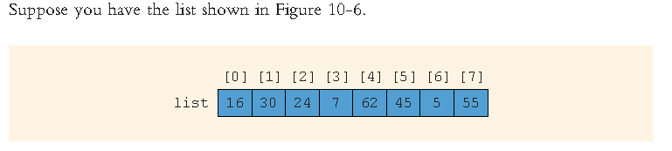
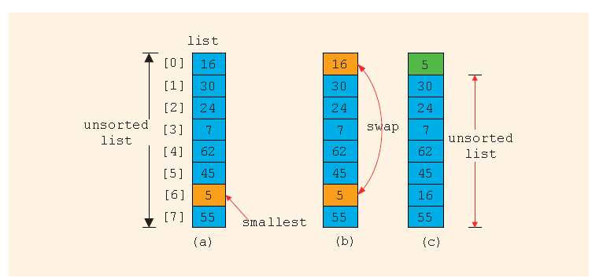
Contd..

Slide 23
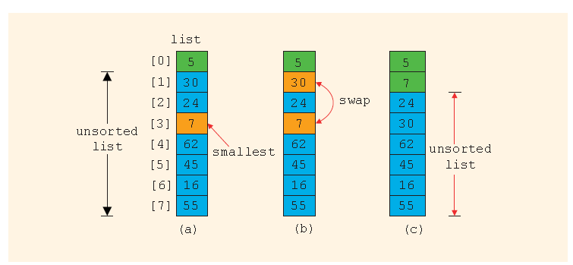
Contd..

Slide 24
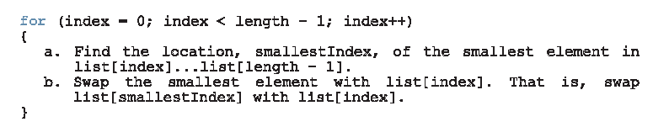
Selection Sort
In the unsorted portion of the list:
Find the location of the smallest element.
Move the smallest element to the beginning of the unsorted list.

Slide 25
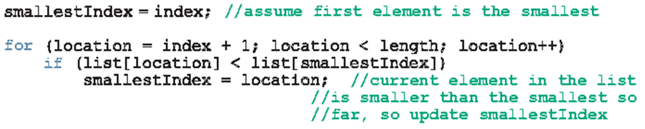
Contd..
Step a is similar to the algorithm for finding the index of the largest item in the list

Slide 26
Contd..
Step b swaps the contents of list[smallestIndex] with list[index]. The following statements accomplish this task:
temp = list[smallestIndex];
list[smallesIndex]= list[index];
list[index] = temp;

Slide 27
Algorithms – Selection Sort
The following function, selectionSort, implements the selection sort algorithm:
void selectionSort(int list[], int length)
{
int smallestIndex, index, location, temp;
for (index = 0; index < length - 1; index++)
{
smallestIndex = index;
for (location = index + 1; location < length; location++)
{
if (list[location] < list[smallestIndex])
smallestIndex = location;
}
temp = list[smallestIndex];
list[smallestIndex] = list[index];
list[index] = temp;
}
}

Slide 28
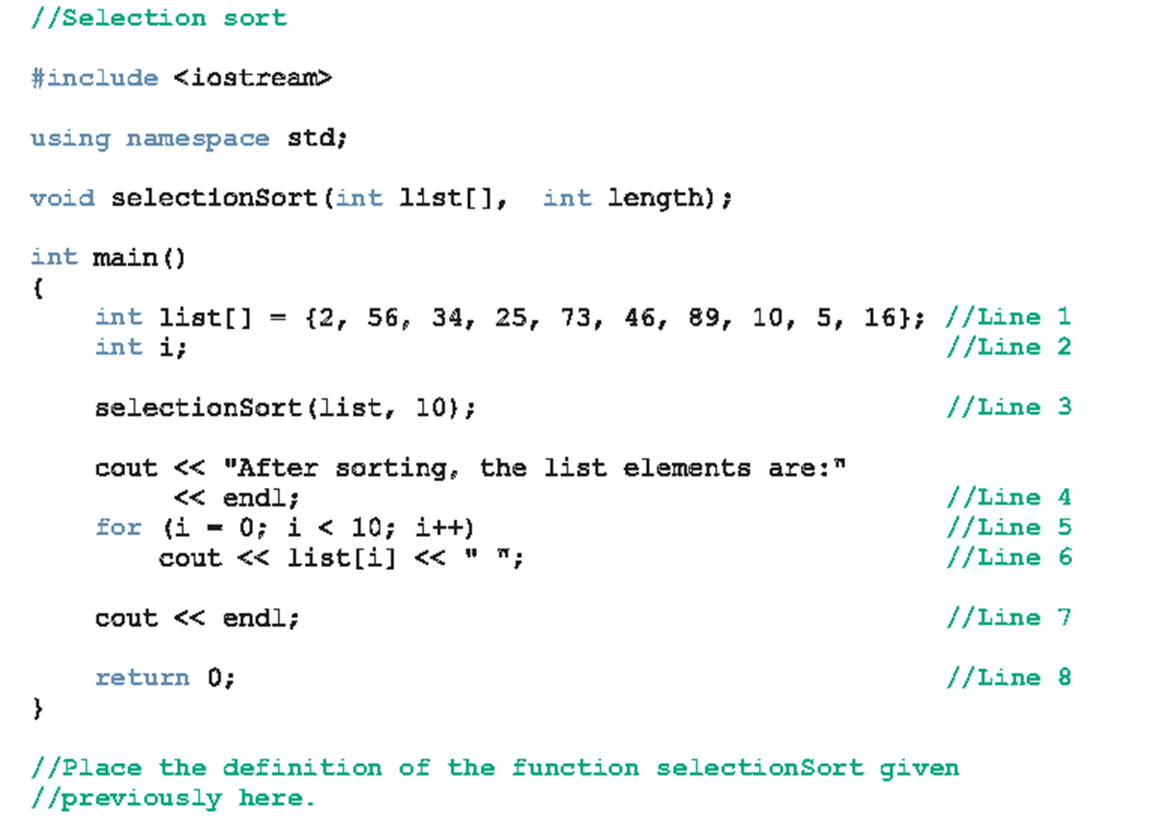
Contd..

Slide 29
Questions

